Slide 1

NETWORK COVERT CHANNEL DETECTION USING MACHINE LEARNING
Presented by: Ambreen Zafar
Chetan Rajpal
Terence Yu
Amad Mohamed

Slide 2
CONTENTS
01. Introduction
02. Overview
03. Methodology
04. Analysis of Results
05. Conclusion

Slide 3
INTRODUCTION
Network covert channels is an evasion technique that employ available
protocols to transmit an unauthorized information
Computer viruses and worms could use covert channels to remain undetected or to exchange necessary information for distributed processing
Covert channels are also used for some non-malicious activities such
as honeypots
Honeypots use covert channels to export logged data to hide it from hackers
Covert channels are divided into two main types: Storage covert channels and
Timing covert channels
Covert channels can be detected by using various techniques

Slide 4
Covert Channels Generation

Slide 5
Generating Covert Channels
Covert TCP
Tunnel Shell
A C program runs in Linux
Generate forged packets and encapsulate a specific information to send it as a split data
This program manipulates the TCP/IP header to transfer a file one byte at a time to the destination host, acting as a client/Server
This can be used to conceal the spy information, by bypassing firewalls/IDS, as innocuous looking packets bypasses the security policy
C program for Linux
works with a client/server model
The server opens a shell that client can access through a
virtual tunnel Works over multiple protocols, including TCP,
UDP, ICMP, and IP to bypass firewalls/IDS
Tunnel shell needs to be run on both endpoints

Slide 6
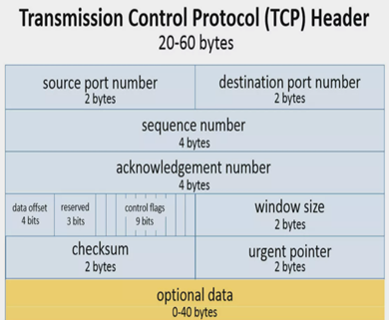
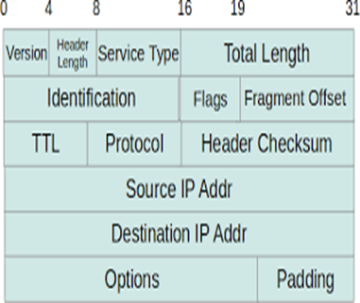
Transmitting data methodology
TCP Header
IP Header

Slide 7
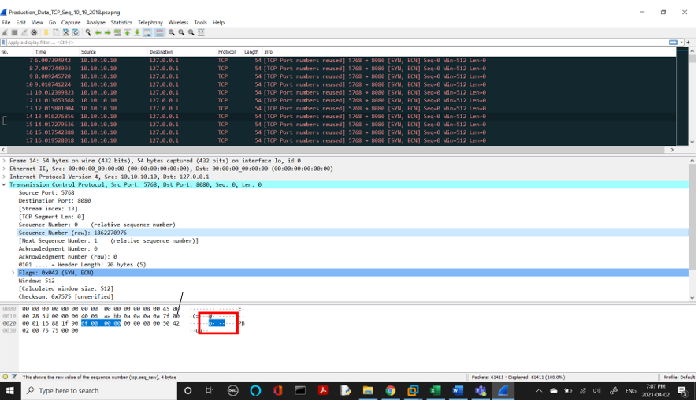
Covert Channels in TCP Packets

Slide 8
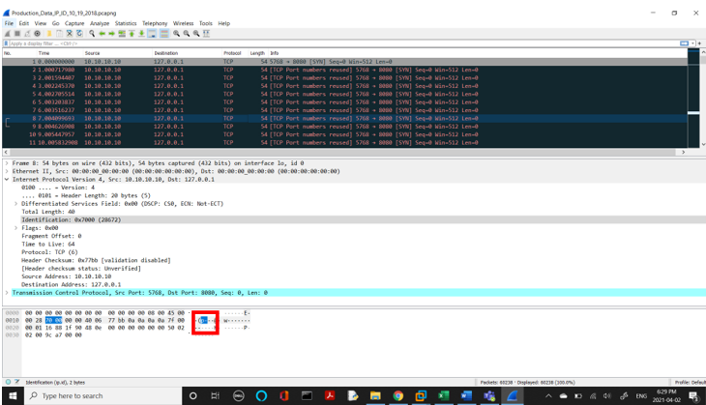
Covert Channels in IP Packets

Slide 9
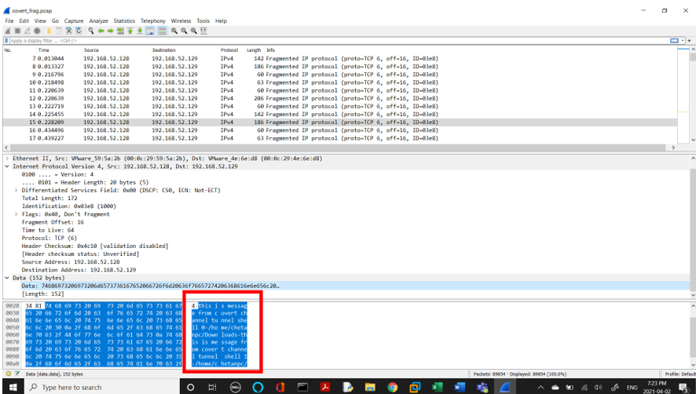
Covert Channels in IPv4 Fragmented Packets

Slide 10
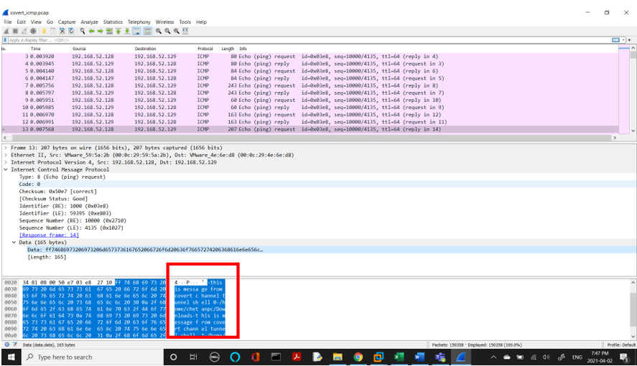
Covert Channels in ICMP Packets

Slide 11
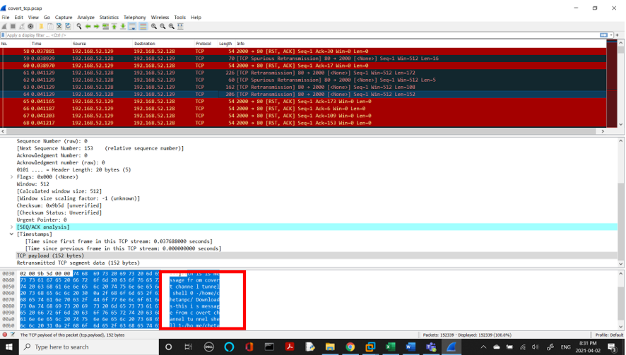
Covert HTTP Channel

Slide 12
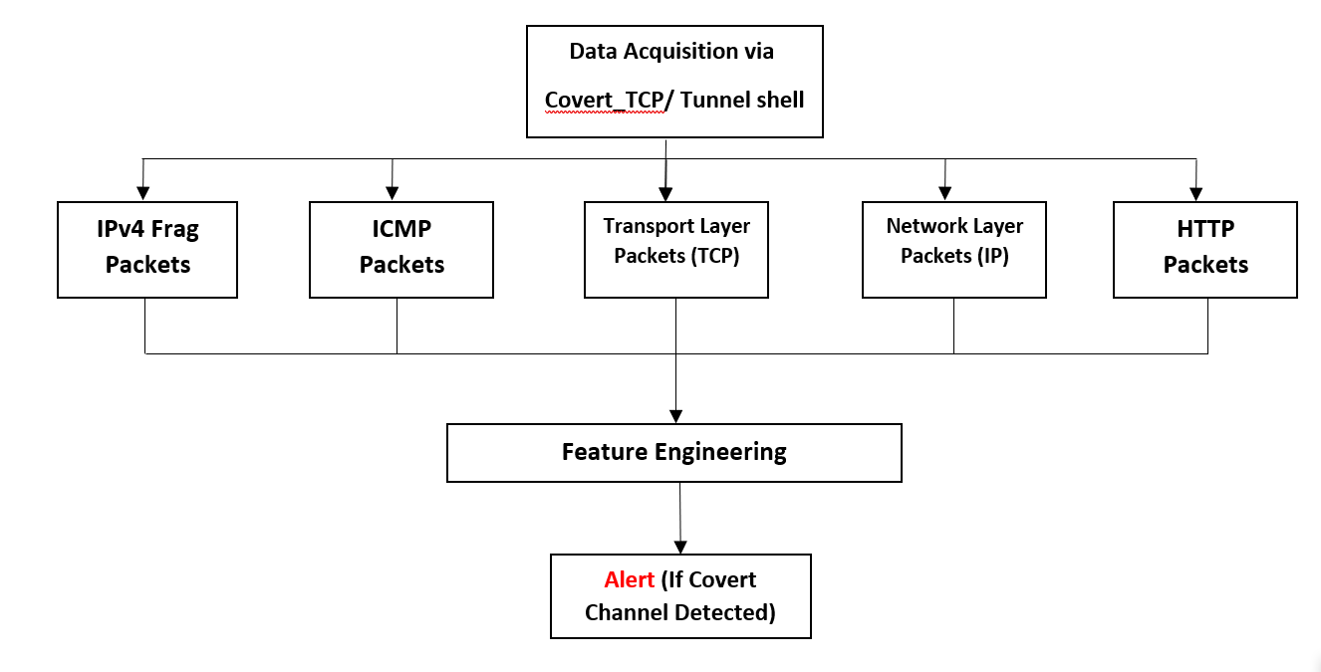
METHODOLOGY

Slide 13
FEATURE ENGINEERING
We then created a data processor so that we can differentiate between protocol specific header elements.
The data processor worked with numerous OSI layers
The requisite features are extracted from the packet data stream after the protocol has been determined.
All the extracted features are then transferred to the program which then detects IP and TCP headers which are necessary for the covert channel detection.
The final dataset, which includes both regular and covert network traffic, can be used in machine learning experiments.

Slide 14
SUPERVISED CLASSIFICATION
The compiled and labelled network dataset which we created is then fed to a supervised classification ML model.
It then analyses and classifies the data to identify traffic comprising network covert channels.
We tried algorithms like K-Nearest Neighbors (K-NN), Gaussian Naive Bayes, Logistic Regression, Decision Tree, Support Vector Machine (SVM), Multilayer Perceptron (MLP) among other supervised classification techniques.

Slide 15
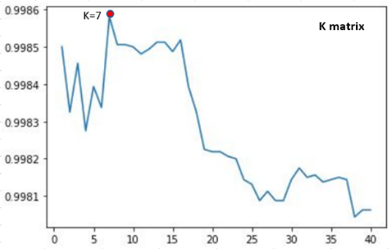
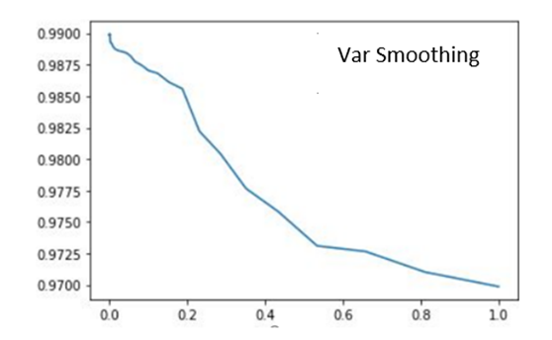
Hyper-Parameter Optimization

Slide 16



Tools Selection

Slide 17
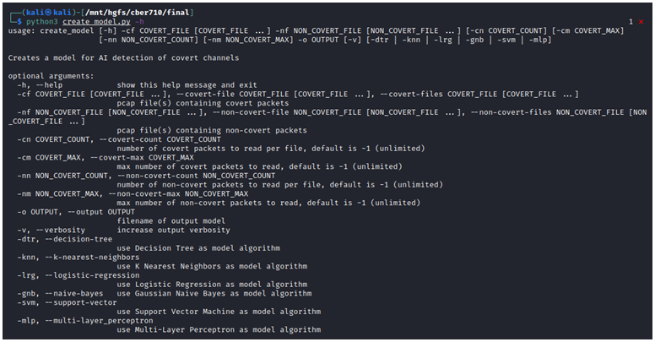
Model Creation
Input
Files for covert packets
Files for non-covert packets
Number of packets to read
- Covert
- Non-covert
ML algorithm to use
Output
Covert channel detector model
- ML model
- Dataset scaler

Slide 18
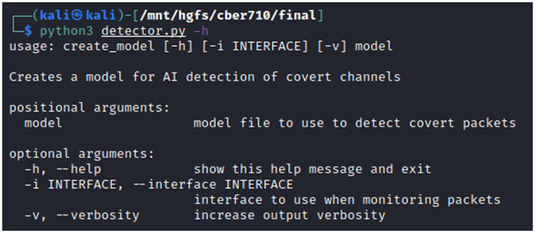
Live Detector
Input
Covert channel detector model
Interface to monitor
Output
Alert messages when ML detect covert packets

Slide 19
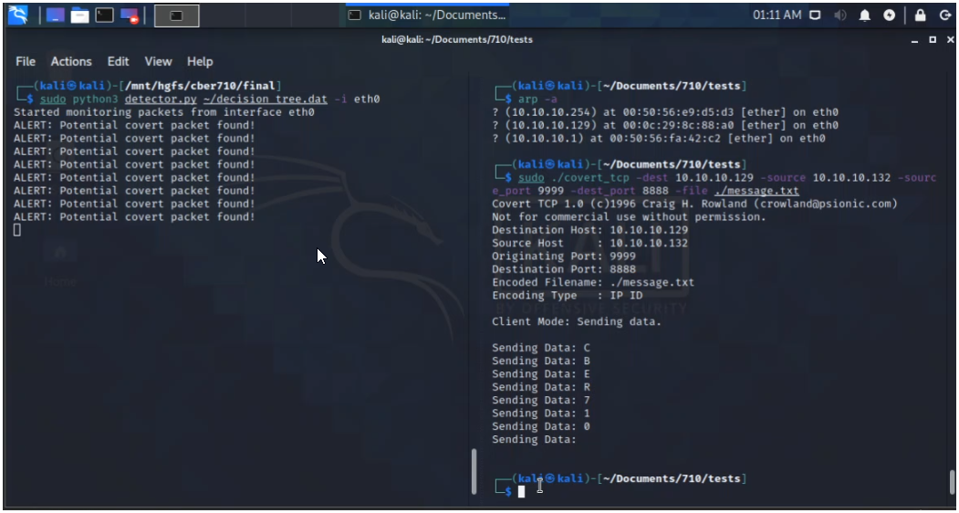
Live Detector Sample Output

Slide 20
RESULTS
KNN
Naïve Bayes
Logistic Regression
Decision Tree
Support Vector
Machine
Decision Tree

Slide 21
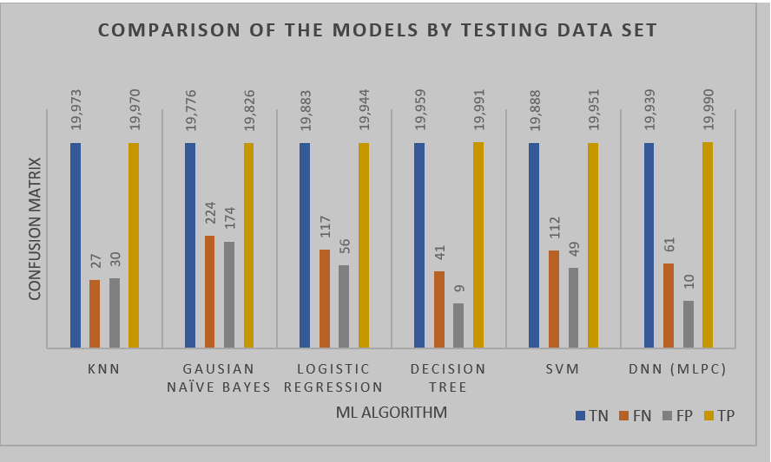

Slide 22
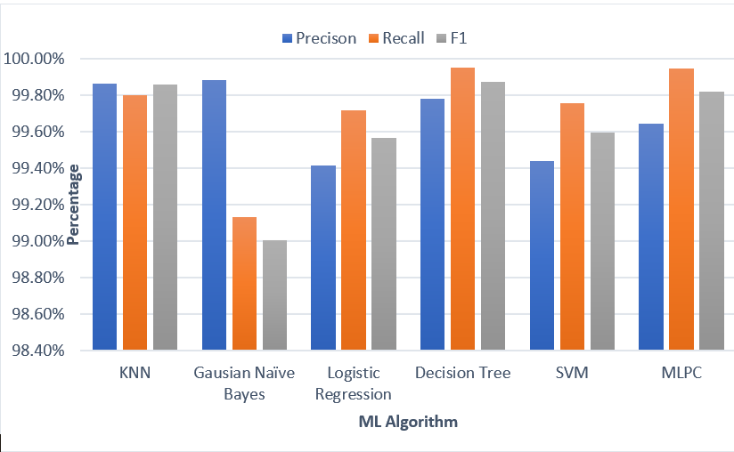

Slide 23
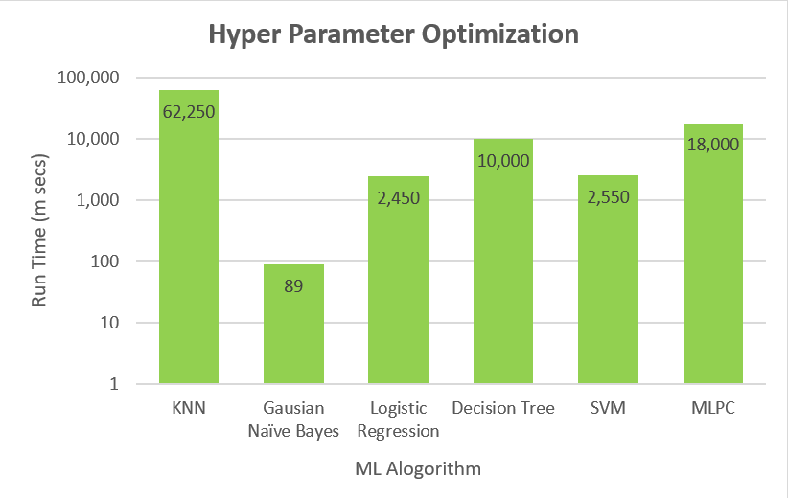

Slide 24
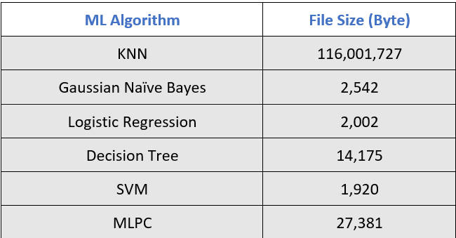
File Sizes of the Model
The dataset has also been tested for the file sizes of the model for live monitoring.
The smaller the file size is better, as it can easily be distributed as AV definition file.

Slide 25
Analysis
KNN and Decision Tree provided the best accuracy results, in terms of Precision, Recall, and F1 score results
KNN performed poorly in terms of processing speed and model size
Decision tree provided the best results, while being able to
process packets fast, at the same time the resulting model is small
enough that it can be distributed easily

Slide 26
Countermeasures against Covert Channels
Improved Network Security & Limiting Bandwidth
Use of active and passive wardens
Use of Protocol Scrubbers and Traffic normalizers
Set unused and reserved fields to zero
Look for number of fragments, fragment size, and fragment rates
Reassemble Original IP packet in between before sending it to receiver.
Block unwanted protocols and ports and perform Ingress/Egress filtering

Slide 27
CONCLUSION
Generated covert and non-covert packets to use them as data set
Detecting network storage channels can be applicable by using ML.
Use six different algorithms, which gave satisfying result as two different
layers
Decision tree proved to be most effective technique, it gives the best result in appropriate time

Slide 28

Thanks

